Slide 1
Text Analytics and Machine Learning with Spark
Submitted by-
Aditya Pathania
A21002
Submitted to-
Praxis Business School
Dr. Prithwis Mukerjee

Slide 2
Idea behind the problem
The project of NLP was done , while I was studying for the Text analytics , I had done the project in the python after getting into the spark world , I tried to solve the problem in the spark itself
The idea of using NLP and the text , Is different than the other machine learning models
The text analytics , can become a little complicated in times
The idea of the project was to identify the authors that might have written the text
We will follow the approach of separating the words, tokens , stop words and then build our specific model
Then we will check our accuracy for our model with the test set

Slide 3
Tools and techniques used
The tools used for the project are -
Spark
Python
Google colab
Matplotlib
NLP: text analysis
SQL context
Spark is the platform we chose to do the project we had installed the spark and started the spark session on the python environment.
We used matplot to visualize the results

Slide 4
Tools and techniques used
We used the google colab platform to do the project
We used the NLP , as we are doing the text analytics
We also used the SQL context to work on the tables
And then for machine learning we used the logistic regression , which gave us good results being a 3 class data
The test data and the train data has been shared as well with the project as well

Slide 5
Problem Statement
In this notebook, we tried to predict the author of excerpts from horror stories by Edgar Allan Poe, Mary Shelley, and HP Lovecraft. The goal of the notebook is not to get too fancy with the choice of the Algorithms but its more on how can you use Spark to achieve or at least try to achieve what you could do using scikit-learn and pandas. The dataset can be downloaded from the Kaggle competition page.According to the dataset there are three distinct author initials we have already been provided with a mapping of these initials to the actual author which is as follows:
EAP - Edgar Allen Poe
HPL - HP Lovecraft
MWS - Mary Shelley

Slide 6
Description of the Problem
In the dataset we had been given text from some authors , that we need to analyse and then use some modelling technique that can be used to predict what texts are written by which user
We had been given 2 datasets , the training dataset and the testing dataset
We tried to analyse the text , create count vectorizer , token vectorizer , transformed the text into vector and then tried to analyse and predict from the token words who the author of the text can be.

Slide 7
Approach to the Problem
Steps that were followed-
1- Creating a spark session and installing all related packages
2- Importing libraries
3- EDA on the dataset
4- Creating different token and word vectorizer
5- Creating hashed words
6- Preparing dataset for the modelling
7- Machine learning

Slide 8
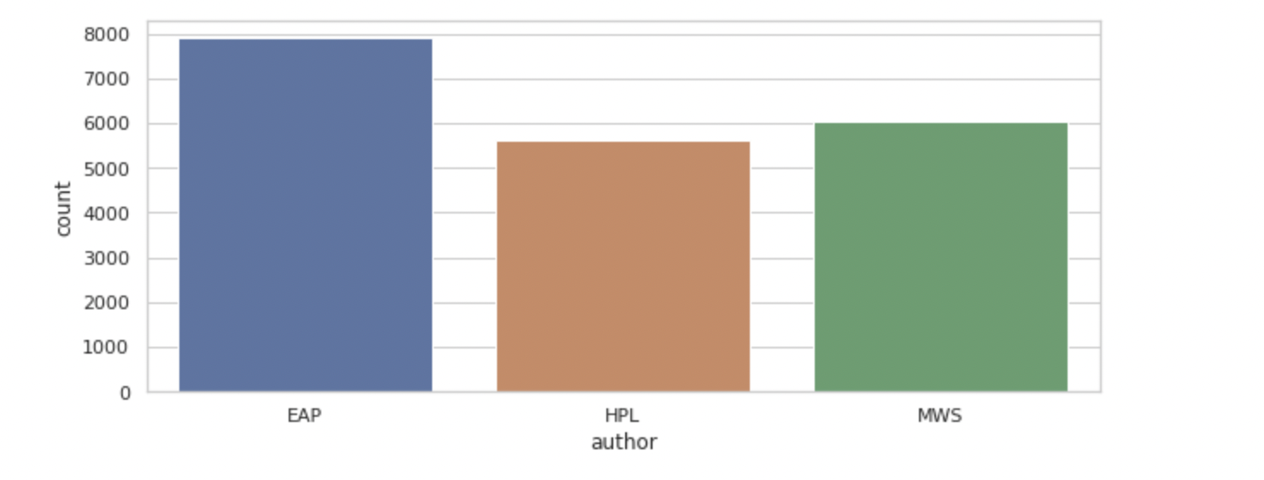
Exploratory Data Analysis-
We started with checking the label , as in how many unique authors we had
As we see there are 3 authors and most of the text count comes from EAP
The lowed count of words are from HPL
We then tried to check some word tokenizers with the Spark

Slide 9
Tokenizer and NLP Transformer
The Idea behind Tokenizer and NLP transformer is that
It helps to analyse the count of the words
It picks up the stop words
It picks up the token words
It helps to transform the text into word vector
I tried to analyse these libraries on the purpose of learning and analysing how with these work with the Spark session
Now as we are using tokenizer and vectorizer , we will need to also check how the word cloud of the stopwords / tokens for each user will look like

Slide 10
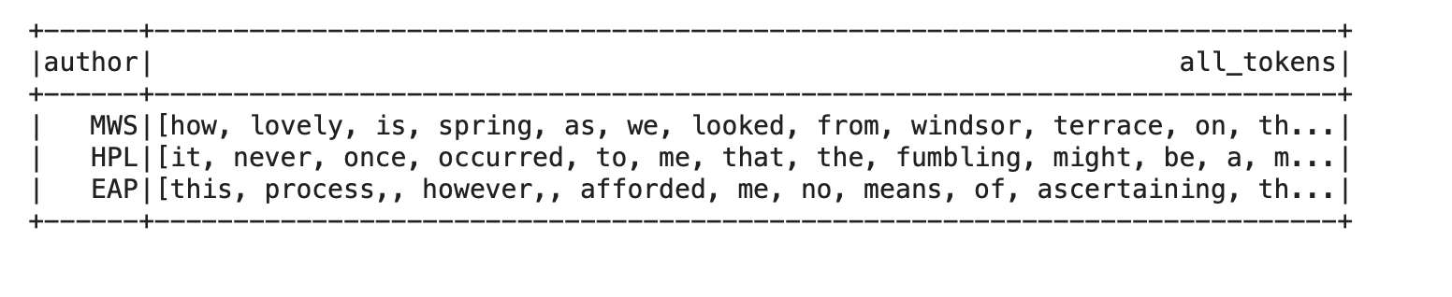
Word cloud / each author
Now as we know we are looking to work for the word cloud with the token vector created but the main issue is -
We need to apply a series of Spark functions to get all the tokens for a given author:Each row in the Dataframe is a token array. So, when we group by each author, we collect tokens as an array of arrays using collect_list function for each author. And, then finally flatten out the array of arrays into one array using flatten function and collect them into the all_tokens column.
This is how group by was used to gather all the array of tokens by each user then the main step was to create a word cloud

Slide 11
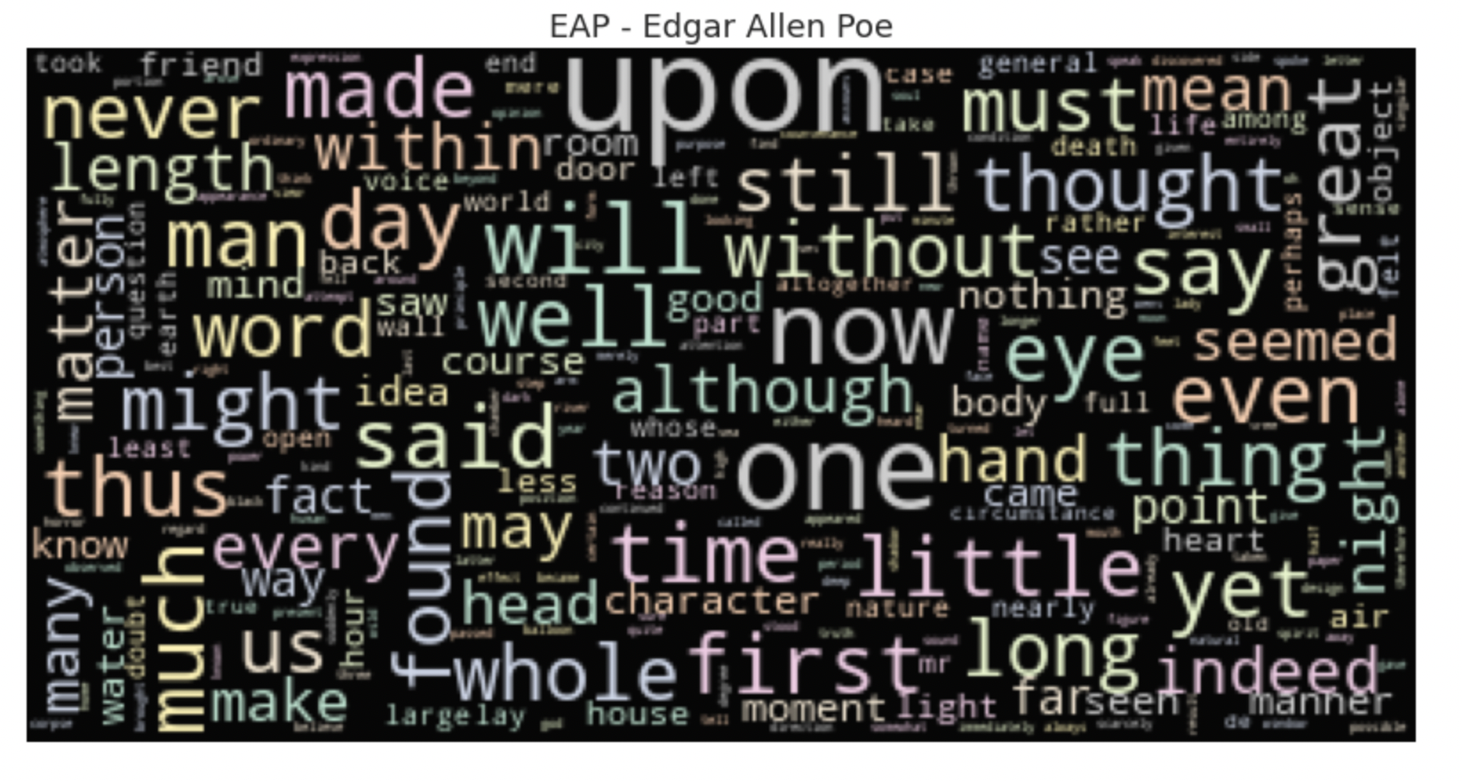
Word cloud-eap
This is the word cloud for EAP -
His works revolved around tales of mystery and the grisly and the grim. We can see the usage of body, head, heart in his works.

Slide 12
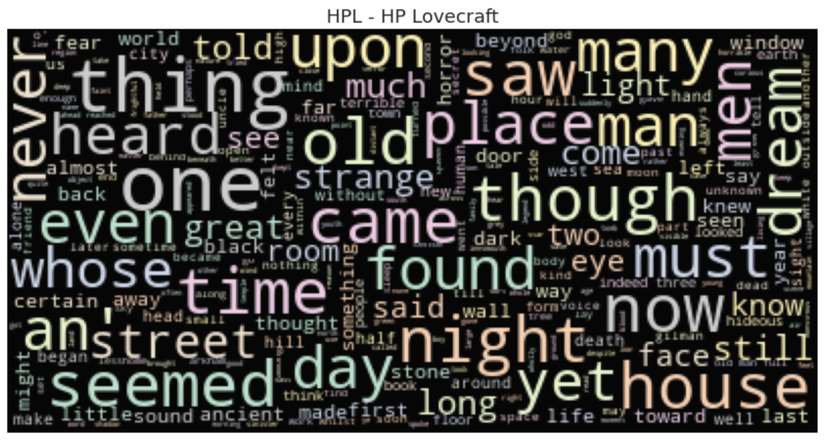
Word cloud-HPL
This is what the word cloud for HPL , looks like
HP Lovecraft's works revolved around fictional mythology. We can see the usage of dream, eye, strange in his works.

Slide 13
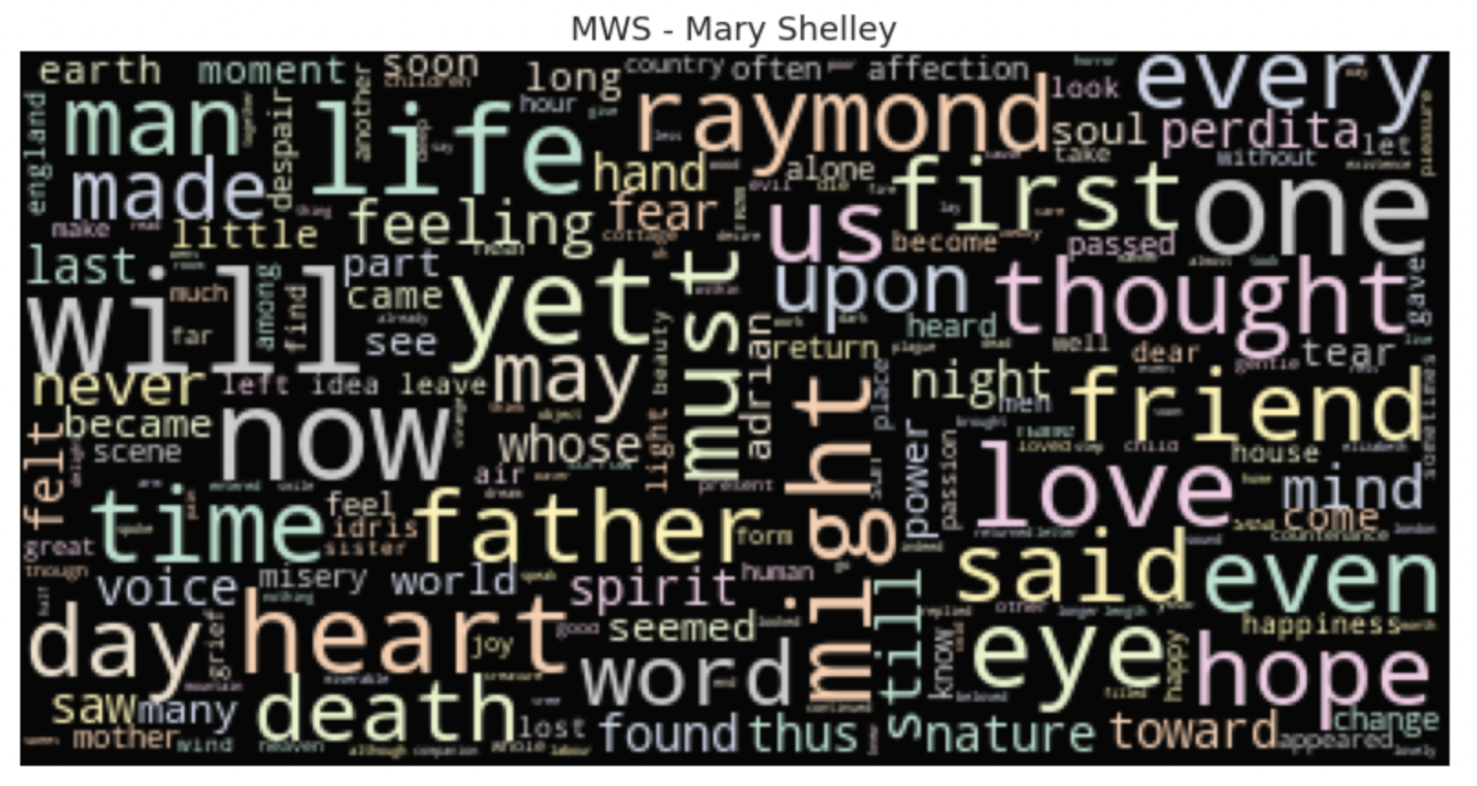
Word cloud - mws
This is how the word cloud for MWS looks like-
Mary Shelley seemed to be a versatile author. I do not find any distinctive choice of words.

Slide 14
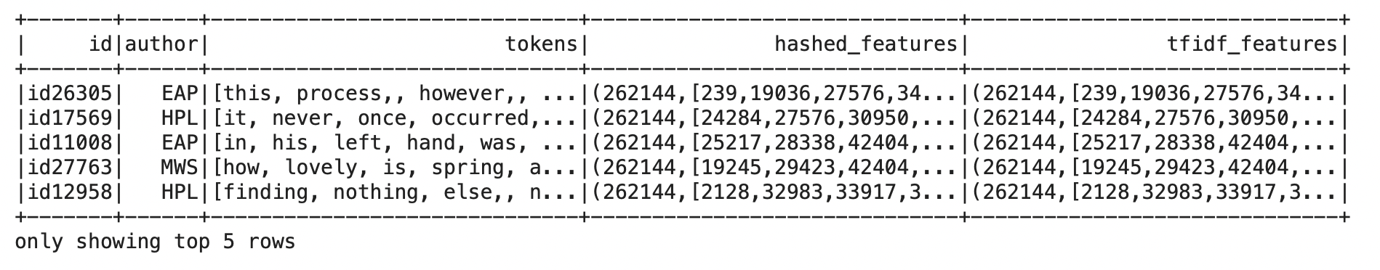
Counting the tokens into hashed feature
The main idea behind this was-
To identify the tokens and the stop words for each user
Once identified count the number of tokens
The tokens count will only help us in the machine learning process
Once have the count of tokens we save a new feature
We first did it manually and then created a vectorizer
The main vectorizer used in NLP is tfidf vectorizer

Slide 15
Advanced tokenizer
Instead of manually doing the tokens , we also have an option to build a custom word tokenizer it includes.
- creating the word tokens
- lemmetize the words
- remove stop words and punctuation
- strip of html and digits.
- count the number of punctuation in the sentence
- count the number of words in the sentence

Slide 16
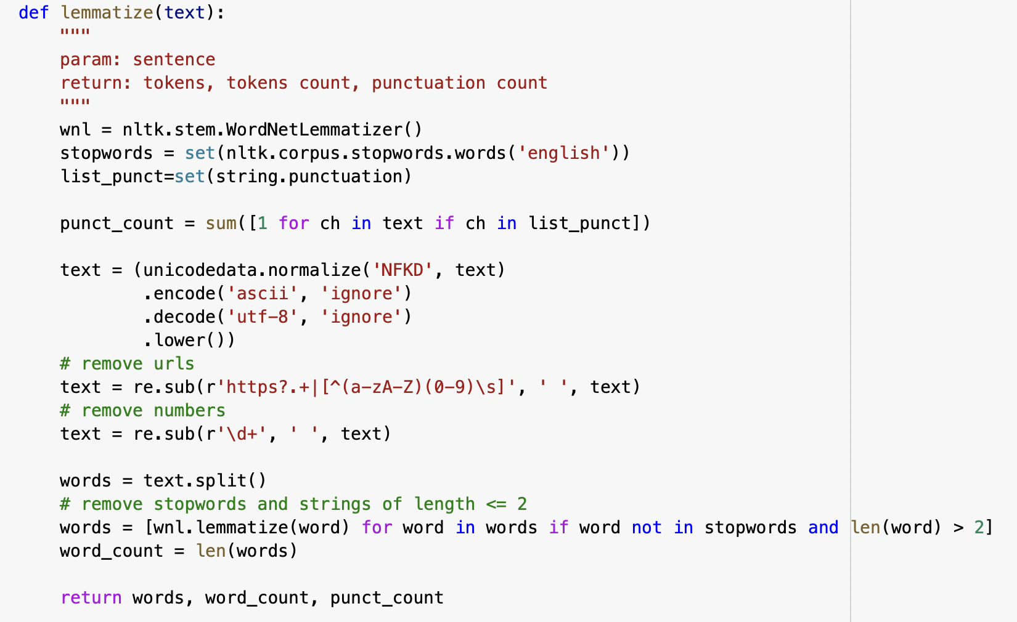
Advanced tokenizer output
This is how a custom function was build to separated out all the features mentioned in the previous slide
The features separated will be used for the machine learning process
The hashed features created were applied to test and train both , and then we used the machine learning for the modelling.

Slide 17
Machine learning
Once we have our hashed features separated as the new column in the table then -
- applied the transformation to the train the test set
- created the labels for the authors using String Indexer
0- EAP , 1- MWS, 2 - HPL
Once we have our labels separated
We created the table separately

Slide 18
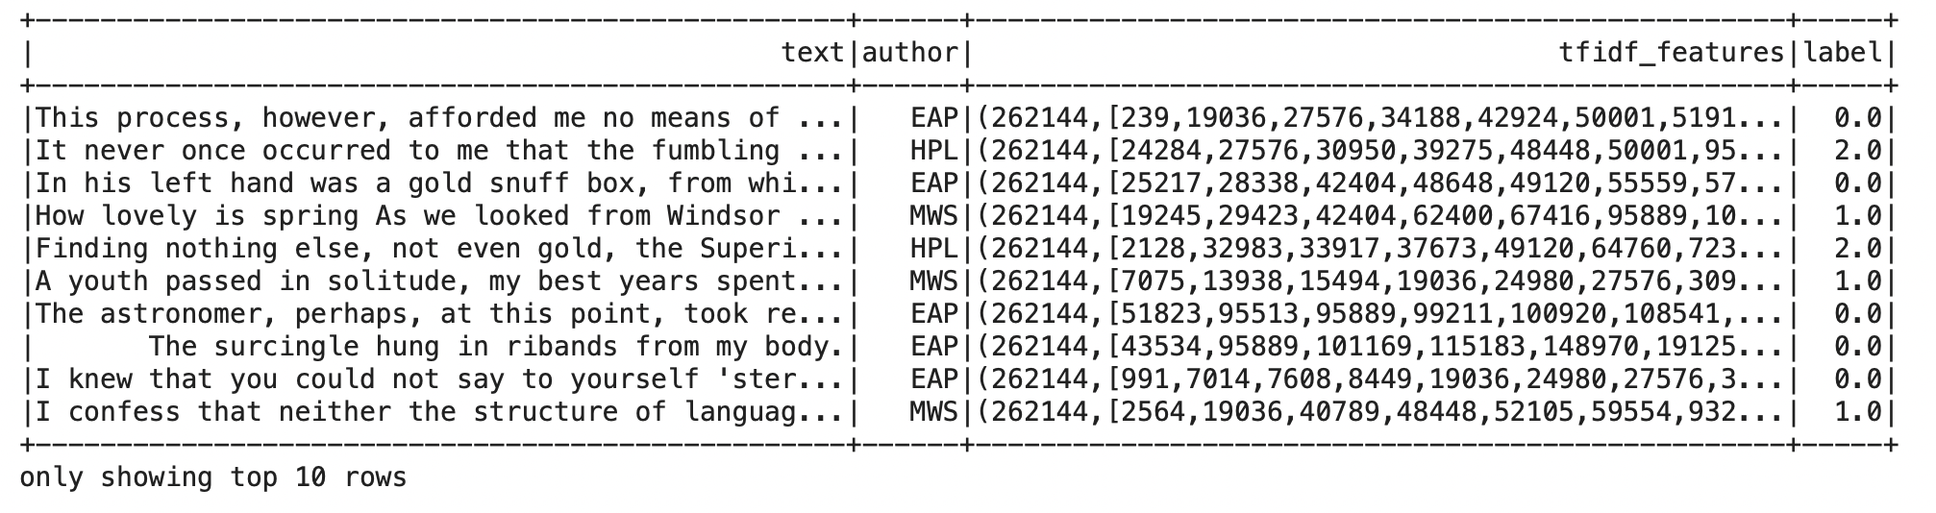
Machine learning
This is how our final dataset looked like , where we had text , author , tfidf_feautes , as discussed earlier the tfidf was used to count and separate the words

Slide 19
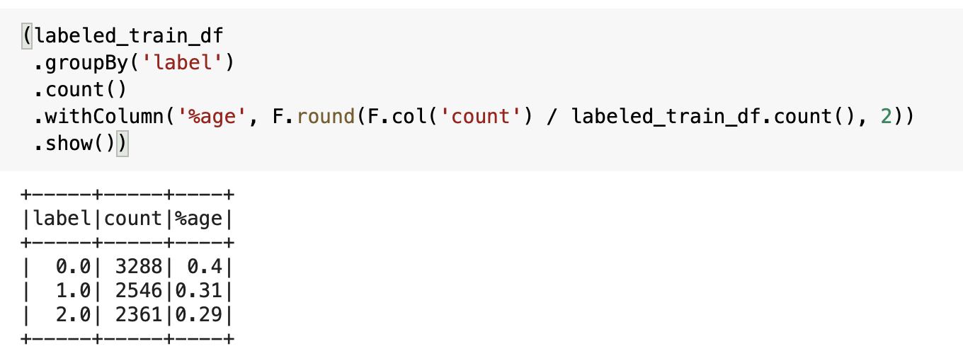
Machine learning
Then we separated the test and the train set in the ratio-75:25
The authors per each set had the ratio of
The ratio for the labels were checked and used according to the validation set as well

Slide 20
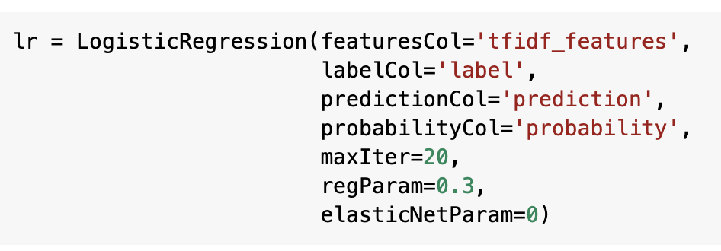
Machine learning
After all the data was prepared we then used the logistic regression model
We took the label as the response variable , and the vectorized transformed input as tfidf_feautes for the x variable

Slide 21
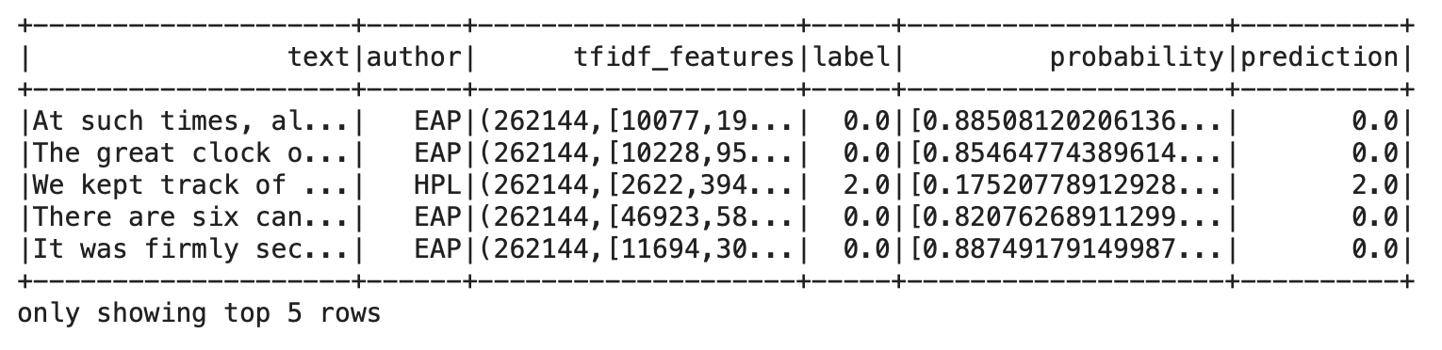
Machine learning
Along with the prediction we also check the probability of text , that these count of the words can appear with such probability
We are getting the predictions with the accuracy of 99 % at the training level of the data , our model has
Actually learned well in the terms of training set
We will check this on our testing now .

Slide 22
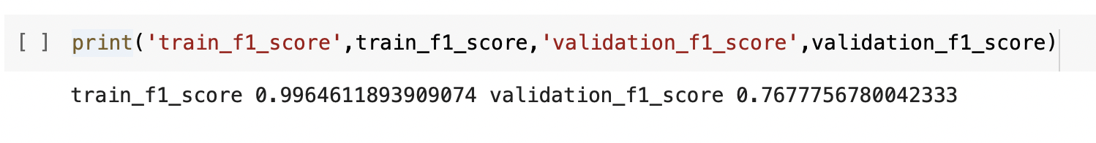
Machine learning
We used a mutliclass evaluator for the results and checked the f1 score
We got the f1 score of 99% at the training set and the score of 77 % the testing set
Out model has performed well on the terms of multi class in the dataset

Slide 23
comments
In the start of the project we discussed our goal for the project , to learn the tokens words , count the token words and predict the author for the text with the count and words vector
We then started our process to visualize the results of the words and the token
We created the count of the tokens , removed stop words
We create tokenizer manually to improve the accuracy of the vectorizer
We then transformed the features into the hashed vector feature
And then we started our process of machine learning

Slide 24
comments
At the machine learning stage our main focus was to predict the author for the text based on the token and the words count
We also find the probability for the text to appear
Finally we were able to do so with the f1 score of 77 % at the validation set
The idea of starting the project went successfully with the good results

